Slide 1
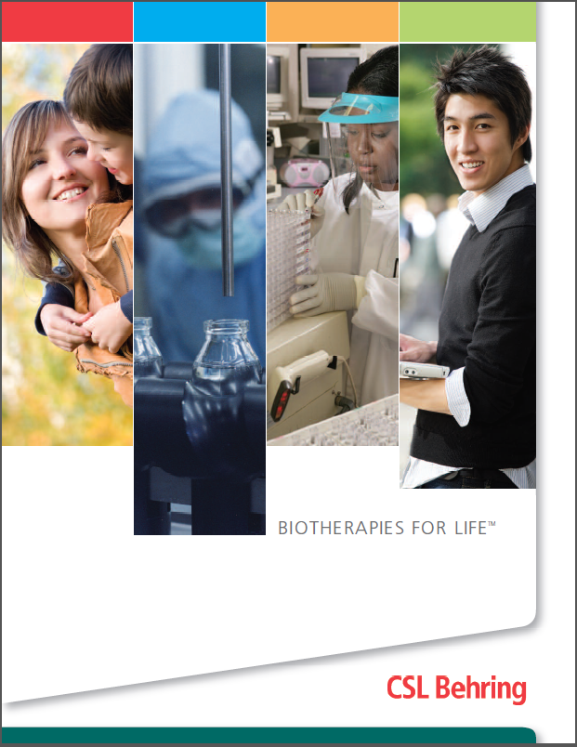

Slide 2
CSL Limited
Headquarters: Melbourne, Australia
12,500+ employees in 26 countries
90+ years experience in the development and manufacture of vaccines and plasma protein biotherapies
12/13 sales revenue: $5 billion
Listed on the Australian Stock Exchange (ASX: CSL) since 1994
www.csl.com.au
Notes:
Updated Sept. 2013 with new sales revenue, US $5 billion
CSL LIMITED is a global, specialty biopharmaceutical company that develops, manufactures and markets products to treat and prevent serious human medical conditions. Innovation and new product development for unmet medical needs continue to drive CSL’s growth. With major facilities in Australia, Germany, Switzerland, US and Japan, CSL has more than 12,500 employees working in 26 countries*. CSL R&D is integrated across the organization.
*Figure confirmed by Ben Rushbrook Sept. 3, 2013.

Slide 3
The CSL Group
Notes:
CSL LIMITED is a global, specialty biopharmaceutical company that develops, manufactures and markets products to treat and prevent serious human medical conditions. Innovation and new product development for unmet medical needs continue to drive CSL’s growth. With major facilities in Australia, Germany, Switzerland, US and Japan, CSL has more than 12,500 employees working in 26 countries. CSL R&D is integrated across the organization.
bioCSL manufactures and in-licenses, markets and distributes biological products for the treatment of serious disease. We have operations in Australia, New Zealand and the USA.
CSL BEHRING is a global leader in the plasma protein biotherapeutics industry. CSL Behring operates CSL PLASMA one of the world’s largest, fully-owned plasma collection networks.

Slide 4
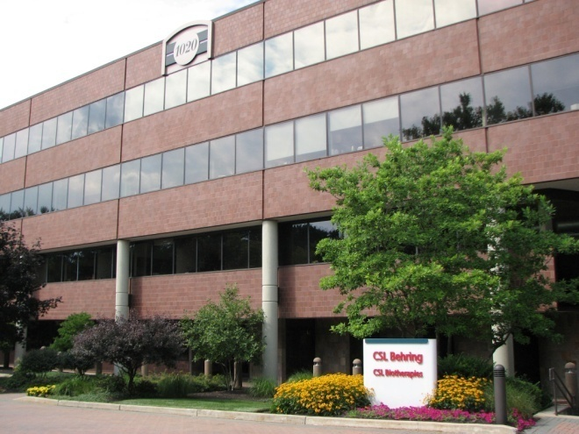
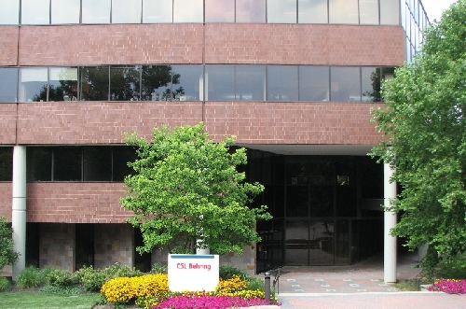
CSL Behring at-a-Glance
Global leader in $19.6 billion plasma therapeutics market
Owns and operates CSL Plasma, one of world’s largest plasma collection networks
Subsidiary of CSL Limited, a biopharmaceutical company with headquarters in Melbourne, Australia
11,700+ employees worldwide
Headquartered in King of Prussia, Pennsylvania, USA
Four manufacturing facilities
Six research facilities
CSL Behring headquarters in King of Prussia
Notes:
Industry size source: Ted Kanigowski (Sept. 2013) – $ 19.6Bn (incl. Plasma + Recombinants) – representing the full year 2012
Employee number from John Martino Sept 2013.
Four manufacturing facilities: Melbourne, Australia; Marburg, Germany; Bern, Switzerland; Kankakee, IL
Six research facilities: Marburg, Germany; Bern, Switzerland; King of Prussia, PA; Tokyo, Japan; Broadmeadows, Australia; Parkville, Australia

Slide 5
CSL Behring FY 2012-13 ~US $4.5 Billion
Notes:
Source: Sept 2013; Kate Johnston.
2012-13 Actual Sales by Therapeutic Area
Immunoglobulins 2,034,110.00
Critical Care 1,132,700.00
rFVIII 484,634.00
Plasma-derived Coagulation 524,270.00
Pulmonary 93,898
Wound Healing 91,723
Other 128,170

Slide 6
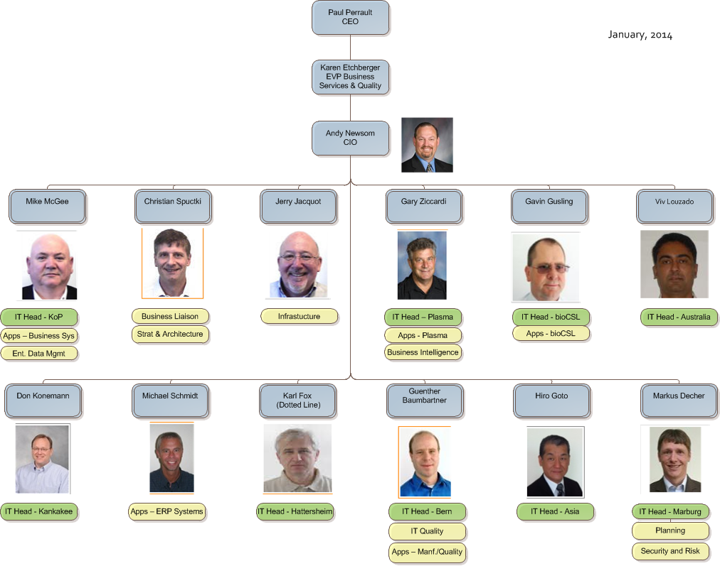
IT Organization

Slide 7
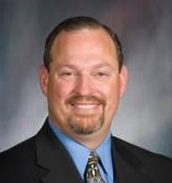
Andy Newsom - Background
Worked in the Pharmaceutical industry over 30 years
CIO of CSL Behring – 4 years
Held various leadership roles in application development and infrastructure
Worked for Armour Pharmaceutical, Rhone Poulenc Rorer, Centeon, Aventis Behring, CSL Behring

