Slide 1
Global Overview
March 2014

Slide 2
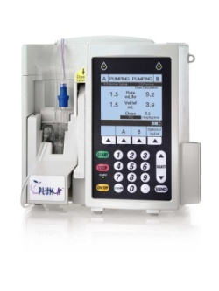
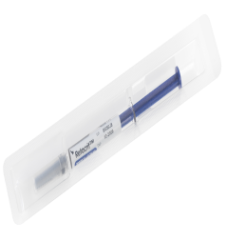
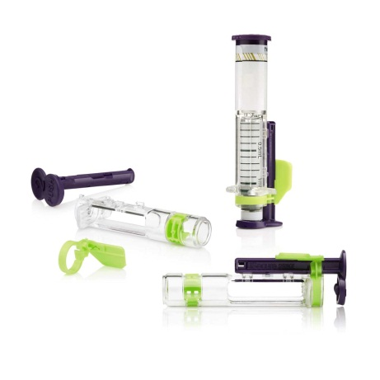
Hospira at a glance
The World’s Leading Provider of Injectable Drugs and Infusion Technologies
Market leadership positions in:
generic injectable pharmaceuticals globally
biosimilars in Europe and Australia
medication management systems globally
Nearly 80 years experience; public independent company since 2004
2013 annual revenues of ~$4B
~17,000 employees
Global overview as of March 2014
2
Notes:
2

Slide 3
Our philosophy
Unwavering Commitment to ...
Our customers and patients, delivering on our promise by serving their needs with integrity, trust and innovation
Our employees, by embracing diversity of thought and cultural perspective, fostering an environment of empowerment, fairness and respect
Our shareholders, by safeguarding their investment and providing a fair return
Our communities, acknowledging our social responsibility through active citizenship and thoughtful giving
Values
Integrity
Ownership/Accountability
Speed
Entrepreneurial Spirit
Vision
Advancing Wellness™… through the right people and the right products
Global overview as of March 2014

Slide 4
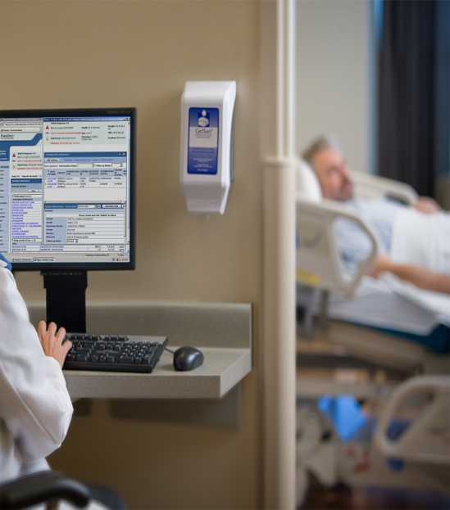
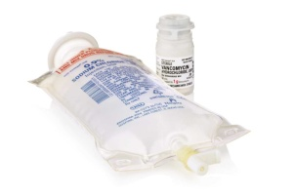
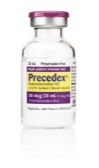
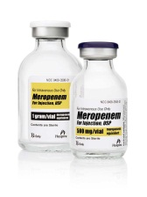
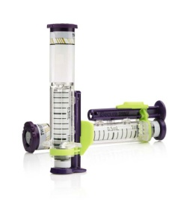
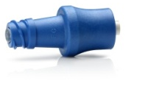
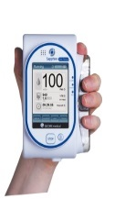
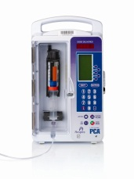
Hospira addresses critical healthcare needs
Key Products
Customers
Critical Needs
Specialty Injectable Pharmaceuticals (SIP)
Global industry leader with portfolio of ~200 products, many in differentiated delivery formats
Hospitals and alternate site healthcare providers
Reducing:
costs
medication errors
infections
Improving:
patient safety
worker safety
productivity
Medication Management Systems (MMS)
Smart infusion devices, dedicated administration sets and software and services
Global overview as of March 2014
4

Slide 5
Hospira product categories
Specialty Injectable Pharmaceuticals (SIP)
Generic injectables Biosimilars Proprietary pharmaceuticals
Medication Management
Medication management systems (MMS): - smart infusion devices - dedicated administration sets - software and services Gravity administration sets
Other Pharma
Large-volume solutions Contract manufacturing
2013 Net Sales ~$4B*
5
Global overview as of March 2014
5
*Net sales are on a GAAP basis. Please refer to Hospira’s fourth-quarter 2013 press release on Hospira.com for detailed financial information.
Notes:
5

Slide 6
Global leadership position
#1 in Generic Injectables
#2 in Devices
Market Value: $9B
Market Value: $2B
Hospira
Hospira
Global Generic Injectable Market (Units)
Global Devices (MMS) (Units)
SIP: Market share represents the unit market of genericized products in which Hospira participates for the U.S., EU5, Australia, Japan, South Korea and Canada. IMS NSP (U.S.) data as of Jan 29, 2013, IMS MIDAS (ex-U.S.) data as of Feb 27, 2013, share figure represents rolling four-quarter data (Q112-Q412). Data excludes the retail channel in the U.S .and other markets. Market value is for Hospira’s served available market. IMS Geographies: U.S., Canada, Australia, EMEA (France, Italy, Spain, UK, Turkey, Saudi Arabia), LATAM (Argentina, Brazil, Colombia, Chile, Mexico, Peru), Asia (China, Taiwan, Hong Kong).
Devices: LVP, Ambulatory, PCA. Includes devices Hospira sells. Source: MDI, Dec. 2012; inMedica: The World Market for Infusion Pumps and Accessories (2011); iNETand Hospira internal analysis.
Global overview as of March 2014
6
6
Notes:
6

Slide 7
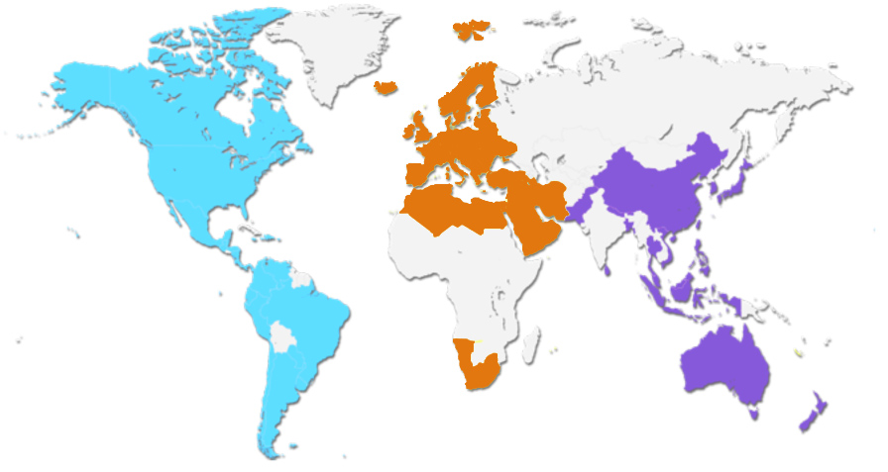
Geographic footprint: room to grow
The Americas
EMEA
APAC
8.0%
79.3%
of 2013 net sales
of 2013 net sales*
12.7%
of 2013 net sales
7
Global overview as of March 2014
*Net sales are on a GAAP basis. Please refer to Hospira’s fourth-quarter 2013 press release on Hospira.com for detailed financial information.

Slide 8
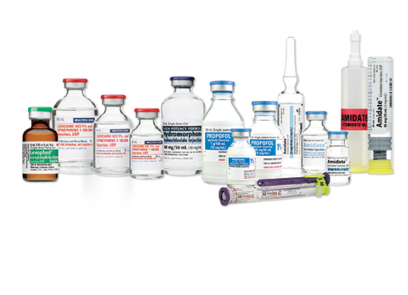
Closer look: Pharmaceuticals
Building on our global market leadership to deliver high-quality generic injectable pharmaceuticals at a reduced cost
One of the broadest generic injectable product portfolios in the world
Proprietary drug-delivery formats, including:
ADD-Vantage™ medication mixing system
iSecure™ and Carpuject™ prefilled syringes
Infusion therapy/I.V. products in innovative, differentiated formats help provide a better and safer environment for patients, healthcare providers and the global community
Global overview as of March 2014
8

Slide 9
Closer look: Pharmaceuticals
Expanding our leadership through first-to-market strategy, broad pipeline, global expansion
Being first-to-market with generic injectable pharmaceuticals
Continuing to build on our robust small-molecule generic pipeline
Through global expansion plan, successfully filed more than 200 cumulative new-to-country submissions in between 2012 and 2013
Global overview as of March 2014
9

Slide 10
A top 3 global biosimilars company
Only North American company marketing biosimilars in Europe and Australia
Retacrit™ (epoetin zeta), launched in Europe in 2008
Nivestim™ (filgrastim), launched in Europe in 2010 2010 and in Australia in 2011
Inflectra™ (infliximab), received European approval in 2013; launch underway in select markets
Initiated Phase III U.S. biosimilar EPO clinical trial in 2011; expect to submit application to FDA in late 2014 or early 2015
Well positioned in R&D, manufacturing and commercialization capabilities
One of the industry’s largest biosimilar pipelines
Building our program through strategic alliances
Global overview as of March 2014
10
Notes:
10
10

Slide 11
Closer look: Devices
Providing differentiated, innovative solutions to address safety and productivity
Proprietary medication management and clinical information technology platforms that enhance patient safety, quality of care and clinician workflow
Plum A+™ general infusion pump
LifeCare PCA™ pain management system
Sapphire™ infusion system, a compact and lightweight
infusion device system frequently used in ambulatory and hospital settings
Significant scale and presence in hospital and alternate-site settings
Streamlining and modernizing our fleet of pumps, as well as better aligning product portfolio with
evolving regulatory environment
Global overview as of March 2014

Slide 12
Closer look: Devices
Providing differentiated, innovative solutions to address productivity and safety
Clinical medical information technology
Interactive, highly sophisticated software systems
Leading the industry’s evolution toward IV Clinical Integration, or IVCI, which integrates medication management devices and technologies with electronic medical records
Supports caregivers in clinical decision process
Hospira MedNet™ safety software
Improves the medication administration process to help reduce medication errors
Tracks drug delivery data and supports reporting and best-practice compliance
Offers wireless, networking and cross-platform interfacing capabilities
Consumables
Dedicated gravity and disposable administration sets
Ancillary devices to prevent clotting and contamination of catheters
Global overview as of March 2014

Slide 13
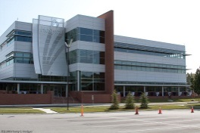
Investing more than $1 billion across our operations
Technology
State-of-the-art quality systems software
New IT systems
Process improvements
Modernization
New pharmaceutical facility in Vizag, India (to begin commercial production in late 2014)
New quality control laboratory at Rocky Mount, N.C.
New automated visual inspection equipment in multiple sites
Equipment, capacity and infrastructure upgrades
Qualifying secondary suppliers for API and manufacturing lines
Streamlining and modernizing our infusion device portfolio
People
New operations and quality leaders
Expanded operations and quality organizations
Upgraded manufacturing technical skills and training
Global overview as of March 2014
13
Notes:
13
13

Slide 14
Significant competitive advantages
Dedicated focus on the generic injectable market
one of industry’s broadest injectable portfolios
largest global market share
differentiated product portfolio with proprietary formats
A global leader in biosimilars with years of experience
Specialized manufacturing expertise and facilities
additional lower-cost capacity coming on line
SIP manufacturing costly to duplicate
Strong and long-lasting relationships with clients and GPOs
Global overview as of March 2014
14
Notes:
14

Slide 15
IT Operation Model and Leadership Structure
15

Slide 16
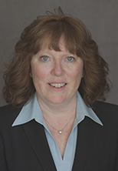
Senior Vice President and Chief Information Officer
 | Mary Gendron brings more than 25 years of experience to her role as Hospira’s senior vice president and chief information officer, reporting to Mike Ball, Chief Executive Officer. Gendron, who joined Hospira in September 2014, is responsible for developing and executing the company’s global information technology (IT) strategies – leading critical day-to-day business support and IT-driven business initiatives. Gendron previously served as senior vice president and chief information officer at Celestica International, Inc., a global contract manufacturer. In that role, she helped architect a complete turnaround of the IT organization, including successful implementation of a quality management system and business analytics platform, as well as transitioning the company to a new global SAP platform across 18 manufacturing sites. Prior to that position, Gendron was a senior vice president at The Nielsen Company, where she was responsible for IT infrastructure shared services; senior vice president and CIO at ACNielsen US; and vice president at Motorola, Inc. She began her career at Bell Canada, where she held a variety of information systems leadership positions. Gendron earned her bachelor's degree in mechanical engineering from McGill University in Canada.

Slide 17
17

