Slide 1
2014 PISA IT Survey Results
16 March 2015
Prepared for: Pharmaceutical Information System Association
Ralph Baskin
Director
Gartner Consulting
ralph.baskin@gartner.com
Project Number: 330026103
Version #3

Slide 2
Table of Contents
2014 Survey Demographics
Executive Summary
Key Findings and Summary Metrics
Detailed Category Review
Gartner Database Demographics - $2B+ Companies

Slide 3
2014 Survey Demographics

Slide 4
Member Participation
Survey participation was 11 out of 21 PISA members
AstraZeneca Biogen BMS Eli Lilly Genentech GSK
J&J Merck Novartis Pfizer Purdue
The scope of the survey covered the Pharmaceutical business only; diagnostics, and consumer/over the counter businesses were excluded.
All of participants did not responded to all of the survey questions, due either to corporate restrictions, definitional differences or an inability to provide the data within the time constraints.
Most participants responded with both global and US only data, but several responded on an either/or basis.
 | Global | US Only
Organization | 9 | 8
Spending | 10 | 8
Metrics | 8 | 8
Priorities | 11
Policies | 11
Initiatives | 11
Spending Priorities | 7

Slide 5
Executive Summary

Slide 6
Findings – Year-to-Year Changes
There were some large shifts from the 2013 data in this year’s survey, some of which can be attributed to the change in participants or their responses
Changes in company FTEs per IT FTE
US only decreased to 14, resulting mostly from some high ratio companies not participating.
Outsourcing spend as a percentage of overall operating expense rose considerably
Several participants reported no outsourcing numbers and the average is driven by a few highly outsourced organizations.
When broken down by revenue size, there’ were some sizable shifts in the metrics.
Global View:
IT spending per company employee is up 30% to $33K in smaller companies
Revenue per employee is up 30% in smaller companies, but down 35% in midsized companies
IT expense as a percent of revenue is up (from 3.8% to 4.9%) in midsized companies along with IT capital investment as a percent of revenue.
Large companies saw a drop in IT operating expense as a percent of company operating expense from 7.8% to 6.7%

Slide 7
Findings – Year-to-Year Changes (continued)
US Only View:
IT spending per company employee is up 50% to $36K in smaller companies, but down 8% in medium sized companies. The Gartner average is also down 8% in midsized companies.
IT spend as a percent of revenue is down over 50% in all of the size categories for US Only.
This extreme change is driven by the change in participants for 2014.
IT operating expense as a percent of company operating expense is up 50% in midsize companies, but down 25% in the large company group.
These large swings are also likely the result of the change in participants for 2014.

Slide 8
Overall Findings
IT spending per overall employee remains nearly 50% higher in the US than on a global basis, in both capital and ongoing operations.
PISA spending per overall employee (globally and US only) continues to be considerably higher than the Gartner average – the US only data set is double the average – although US only revenue per employee is nearly double the Gartner average. Revenue per employee on a global basis is on par with the Gartner average.
PISA IT spending per employee is similar to financial service companies who also have high regulatory requirements.
PISA overall spending distributions (hardware, software, personnel and outsourcing) diverge from the Gartner average in outsourcing where the levels are considerably higher (42% globally and 57% US vs. 27% for the Gartner average). There are differences in the distribution to IT functional areas; PISA places much more resources into applications development (up over 30% from 2013) and support than average and less in end-user and data center areas.
Capital spending for the current year is again expected to rise in both the global and US views despite anticipated flat or declining revenue and operating expense. The Gartner database indicates expected increases in both revenue and operating expense.
Despite fluctuations in the size demographic breakdowns, both global and US IT spending as a percent of revenue remain relatively flat – only 1/10 of a percent rise.
In the US, total IT spending (capital and operating) increased to 7.6% of overall operating expense – still nearly double the Gartner average of 3.9%.

Slide 9
Overall Findings
The mix of contractors to in-house IT staffing has changed for 2014
Contractor use rose to 34% in the global view, but decreased to 25% in the US.
Research and Development and Marketing and Sales dominate the work effort both globally and in the US, albeit with small decreases in the US. Manufacturing and Operations has a larger share of the work effort in the global view than in the US.
Applications age shows some changes. US applications older than five years increased to nearly half the portfolio (47%), matching the global view. However, the percentage of global applications less than three years old moved up to 30%.
Software as a Service (SaaS) continues to grow in the US view (now up to 17%), but still makes up a small percentage of applications hosting model.
In social media, the use of Yammer and blogs continue as the predominant networks but Twitter has replaced Wikis as next in line. Knowledge sharing and networking are now matched as the primary objectives with content sharing decreasing.
No participants responded that e-Pedigree and Product Serialization were on hold in 2014 compared with 15% and 8% respectively in 2013.
PISA investment priorities vary from the Gartner rankings.
Collaboration, digitalization and industry specific applications are much higher priorities for PISA while networking, ERP, and security rank lower.

Slide 10
Summary Metrics and percentage change from 2013
2014 Metric | Global | US Only | Gartner Avg.
Company FTE per IT FTE (including contractors) | 25 ** | 14 ** | 31
Company FTE per In-house IT FTE | 32 ** | 23 ** | 43
IT Expense Spending per Company FTE | $23,103 dn 2% | $34,103 flat | $17,428 up 7%
Revenue per Company FTE | $644,776 up 7% | $1,138.648 up 10% | $656.525 up 2%
IT Expense (capital & operating) % of Revenue | 3.7% up 7% | 3.3% up 10% | 3.9% up 2%
IT Capital Investment % of Revenue | .5% up 25% | .6% dn 2% | .9% up 29%
$ Spend Outsourced (including Transmission) as % of IT OpEx | 42.3% ** | 51.6% ** | 26.8% dn 37%
$ Spend Outsourced – Managed Services only | 23.9% | 17.8% | N/A
IT OpEx as % of Company OpEx | 5.9% flat | 6.6% up 12% | 2.8% up 3%
Highest Ranked Investment Priority | BI/Analytics |  | BI/Analytics
Highest Ranked IT Activity | Increasing Enterprise Growth |  | N/A
** year-year changes were highly impacted by the change in survey participants and not reported here
Gartner 2014 averages are derived from 726 enterprises across all industries with revenue above $2 billion per year

Slide 11
Summary Metrics – Global Grouped by Revenue (PISA/Gartner)
2014 Metric | < $16B | $16B - $30B | >$31B
Company FTE per IT FTE (including contractors) | 20/27 | 39/24 | 20/29
Company FTE per In-house IT FTE | 28/35 | 44/38 | 27/43
IT Expense Spending per Company FTE | $33,007/$17,073 | $21,315/$18,784 | $19,046/$14,947
Revenue per Company FTE | $950,766/$636,539 | $437,033/$688,965 | $595,653/$687,081
IT Expense (capital & operating) % of Revenue | 3.8%/3.0% | 4.9%/3.2% | 3.1%/2.6%
IT Capital Investment % of Revenue | .7%/.8% | .6%/.7% | .5%/.9%
$ Spend Outsourced (including Transmission) as % of IT OpEx | 38%/26% | 34%/28% | 9.6%/33%
IT OpEx as % of Company OpEx | 4.9%/2.6% | 5.5%/2.2% | 6.7%/2.4%
Highest Ranked IT Activity (PISA) | Increasing Enterprise Growth | None ranked highest by more than 1 | None ranked highest by more than 1
Gartner 2014 averages are derived from global enterprises across all industries with revenue above $2 billion per year

Slide 12
Summary Metrics – US Only Grouped by Revenue (PISA/Gartner)
2014 Metric | < $8B | $8B - $13B | >$13B
Company FTE per IT FTE (including contractors) | 12/27 | 14/29 | 16/40
Company FTE per In-house IT FTE | 21/36 | 28/50 | 21/64
IT Expense Spending per Company FTE | $36,774/$16,019 | $46,344/$15,551 | $25,239/$14,589
Revenue per Company FTE | $1,374,179/$691,418 | $1,250,466/$740,319 | $907,083/$562,983
IT Expense (capital & operating) % of Revenue | 2.7%/3.1% | 3.7%/2.4% | 3.3%/2.9%
IT Capital Investment % of Revenue | .3%/.7% | .4%/.8% | .8%/.8%
$ Spend Outsourced (including Transmission) as % of IT OpEx | 51%/22% | 77%/20% | 20%/27%
IT OpEx as % of Company OpEx | 5.5%/2.8% | 9.6%/2.6% | 5.3%/2.9%
Highest Ranked IT Activity (PISA) | Improving IT Applications and Infrastructure | Reducing Enterprise Costs | Increasing Enterprise Growth
Gartner 2014 averages are derived from US enterprises across all industries with revenue above $2 billion per year

Slide 13
Detailed Category Review

Slide 14
IT Organization – Size and Growth
Gartner avg. =
1,174
Estimated at -.75% for 2014
Estimated at -.4.5% for 2014
Note: Gartner does not currently track this metric

Slide 15
IT Organization: Company vs. IT
Gartner avg. = 5.4%
Note: Gartner does not currently track this metric

Slide 16
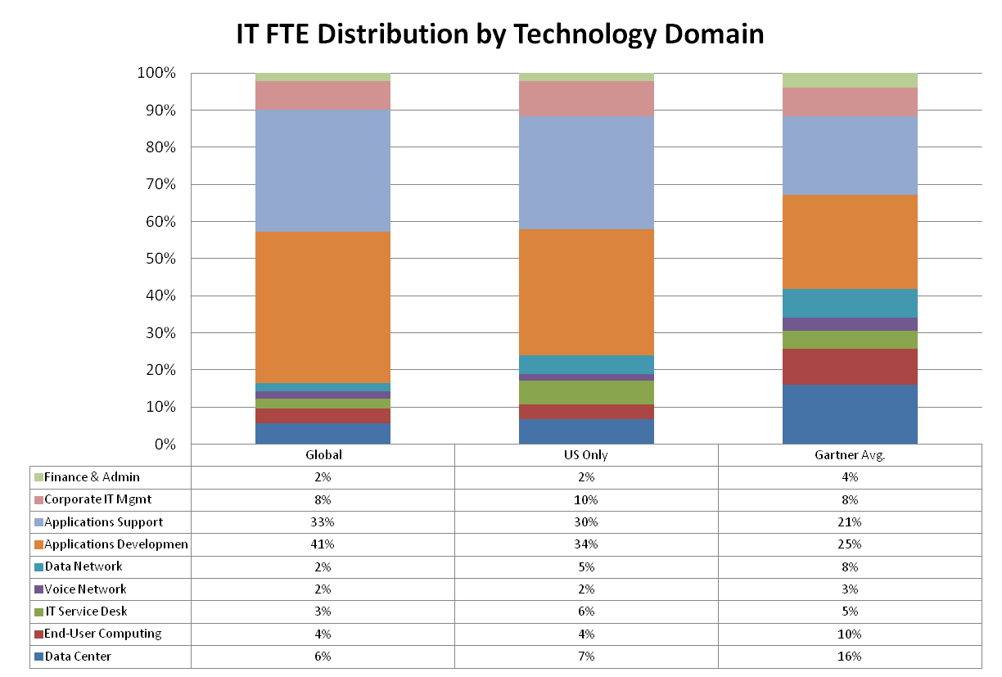
IT Organization: FTE Distribution
Up from 36%
Up from 23%
Down from 8%
Down from 9%

Slide 17
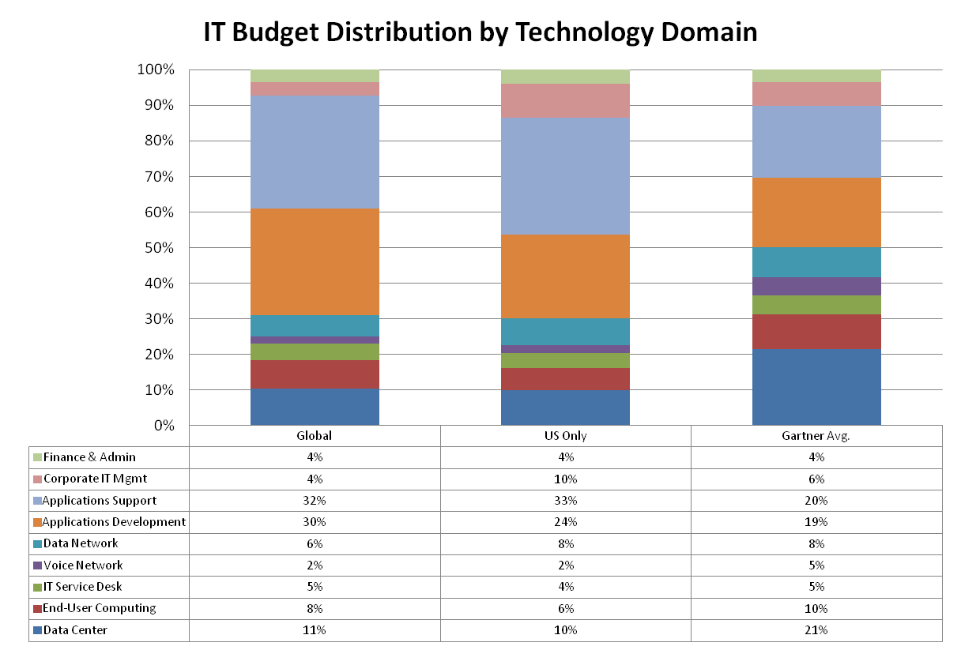
IT Spend: Budget Distributions
Up from 7%
Down from 36%
Up from 22%
Up from 21%
Down from 24%
Up from 16%

Slide 18
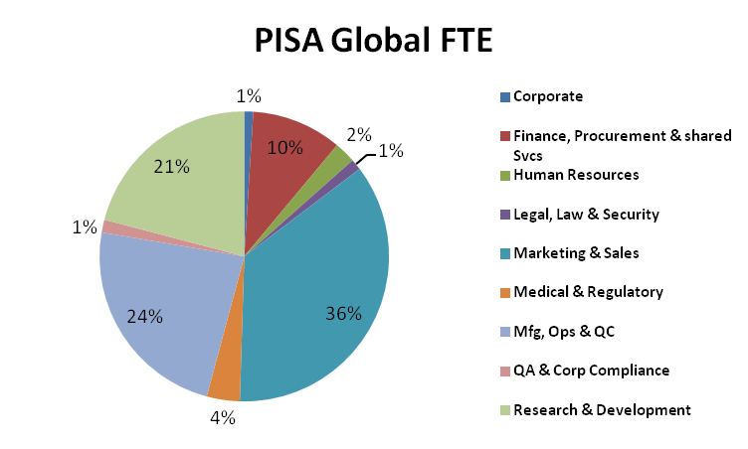
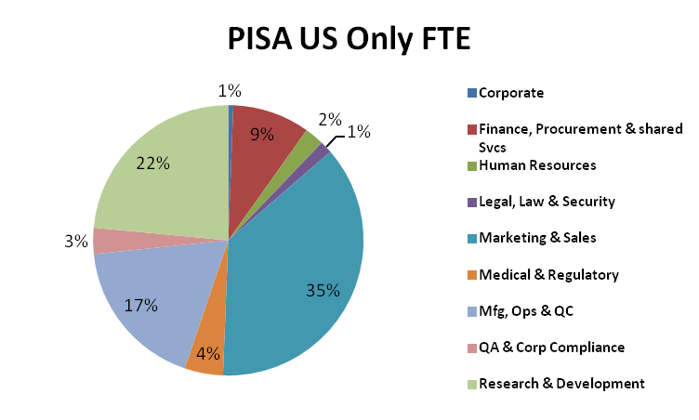
IT Organization – Applications Development & Support Work Distribution
2013 Percentages where > 10% Change
Finance 14%
Marketing 33%
Mfg. Ops 21%
2013 Percentages where > 10% Change
Finance 13%
Marketing 28%
R&D 26%
Note: Gartner does not currently track these metrics

Slide 19
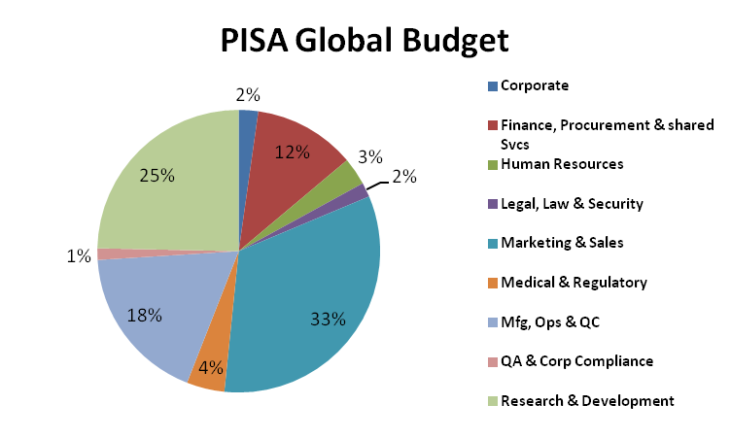
IT Organization – Applications Development & Support Budget Distribution
2013 Percentages where > 10% Change
Corporate 1%
Finance 15%
Med./Reg. 3%
2013 Percentages where > 10% Change
Finance 13%
HR 3%
Legal/Law 3%
R&D 23%
Note: Gartner does not currently track these metrics

Slide 20
IT Spend: Capital and Operating as % of Overall Revenue and Operating Expense

Slide 21
IT Spend: Trend - Capital and Operating as % of Revenue
IT Spending % of Revenue
 | 2010 | 2011 | 2012 | 2013 | 2014
Global | 3.1% | 2.8% | 3.3% | 3.6% | 3.7%
US Only | 3.9% | 3.0% | 3.6% | 3.4% | 3.3%
Gartner Avg. | 3.4% | 3.2% | 3.3% | 3.0% | 3.2%
Gartner Averages are derived from 726 enterprises with revenue above $2 billion per year

Slide 22
IT Spend: Expected Changes

Slide 23
IT Spend: IT Operating Expense and Capital as % of Company Operating Expense

Slide 24
IT Spend: IT Operating Expense and Capital as % of Revenue

Slide 25
IT Spend: Capital vs. Operating Expense

Slide 26
IT Spend: Per Company Employee

Slide 27
IT Spend: Outsourcing
**
** Gartner does not separate Managed Services from Transmission in its database

Slide 28
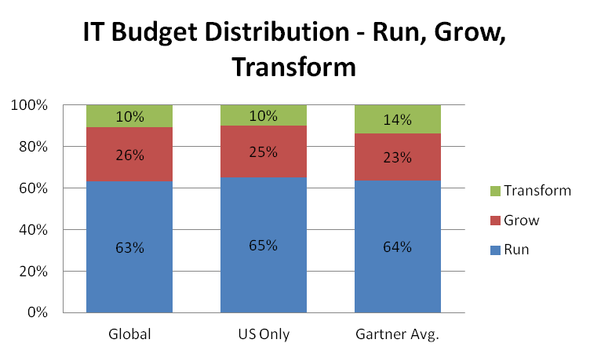
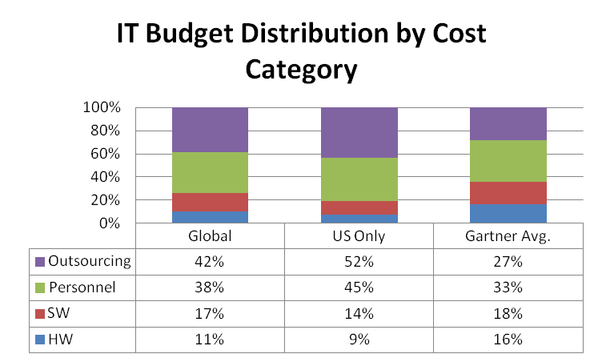
IT Spend: Budget Distributions

Slide 29
IT Metrics: Age of Applications and Hosting Model - Definitions
The age of the applications in use was determined by the point in time the application was first developed or substantially re-engineered.
The hosting models are defined as:
Internal: Company owned or outsourced data centers where the company has some or complete control over the environment itself and how it’s managed.
Cloud: Company developed applications are run on vendor provided platforms that are charged based on a choice of standard configurations.
SaaS: A software subscription model where vendor provided software is hosted and delivered via the internet. Hardware and software maintenance costs are borne by the vendor.

Slide 30
IT Metrics: Age of Applications and Hosting Model
Note: Gartner does not currently track these metrics

Slide 31
IT Policies: Social Networks
Note: Gartner does not currently track these metrics

Slide 32
IT Initiatives: Product Serialization & e-Pedigree
Note: Gartner does not currently track these metrics

Slide 33
IT Initiatives: Business Strategies
Strategy | PISA 2014 Ranking | PISA 2013 Ranking
Increasing enterprise growth | 1 | 1
Improving IT applications and infrastructure | 2 | 4
Improving business process | 3 | 6
Implementing analytics and big data | 4 | 7
Delivering operational results | 5 | 9
Attracting and retaining new customers | 6 | 8
Improving efficiency | 7 | 5
Attracting and retaining the workforce | 8 | 3
Creating new products or services | 9 | 10
Reducing enterprise costs | 10 | 2

Slide 34
IT Initiatives: Investment Priorities
Investment Priority | PISA Ranking | Gartner Ranking
BI / Analytics | 1 | 1
Digitalization/Digital Marketing | 2 | 7
Industry-specific Applications | 3 | 9
Collaboration | 4 | 12
Mobile | 5 | 3
Cloud | 6 | 5
Legacy Modernization | 7 | 11
Infrastructure and Data Center | 8 | 2
ERP | 9 | 4
Customer Relationship Management | 10 | 10
Networking, Voice and Data Communications | 11 | 6
Security | 12 | 8

Slide 35
Demographics – Gartner $2B+ Companies Spending as Percent of Revenue and OPEX
Industry | IT Spend % Revenue | IT Spend % OPEX
Accident And Health Insurance And Medical | 3.0% | 3.1%
Chemicals And Allied Products | 2.5% | 3.3%
Civic, Social, And Fraternal Associations | 6.8% | 7.9%
Colleges, Universities, Professional Schools, And | 3.6% | 3.7%
Communications | 5.0% | 5.7%
Computer Programming, Data Processing, And | 4.5% | 5.8%
Construction | 1.7% | 2.0%
Consumer Goods | 2.3% | 2.8%
Drugs | 3.0% | 3.8%
Electric, Gas, And Sanitary Services | 2.3% | 2.8%
Electrical Industrial Apparatus | 2.0% | 2.3%
Electronic And Other Electrical Equipment And Components, Including Computer Equipment | 2.5% | 2.9%
Finance, Insurance, And Real Estate | 2.1% | 2.6%
Financial Services | 5.3% | 7.6%
Fire, Marine, And Casualty Insurance | 3.2% | 3.9%
Food And Kindred Products | 1.5% | 1.9%
Health Services | 4.4% | 4.6%
Hospitals | 3.3% | 3.4%
Insurance | 1.4% | 1.5%
Insurance Carriers, Not Elsewhere Classified | 3.5% | 3.4%
Life Insurance | 2.1% | 2.3%
Manufacturing | 1.4% | 1.8%
Mining | 1.9% | 2.4%
Oil & Gas | 1.6% | 2.3%
Retail Trade | 1.7% | 2.2%
Services | 3.9% | 4.8%
Transportation | 2.7% | 3.3%
Transportation Services | 4.6% | 4.6%

