Slide 1
2014 Annual Meeting
Hybrid Public and Private Cloud
Sue-Jean Lin, Allergan
Sharon Solomon, AstraZeneca
Todd Pierce, PISA Alum & SFDC

Slide 2
Agenda
  The rise of hybrid cloud
  Opportunities and challenges of hybrid I.T. in Pharma
  Integration of cloud
  Security and compliance strategy in identity, data and change management
  The new IT operating model for the cloud
  Summary of key messages

Slide 3


What Is a Hybrid Cloud?
Private Cloud
Public Cloud
A hybrid cloud is a connection that allows pieces/parts of the application or data to live in one cloud while other parts or services live in another.
Critical or Sensitive Functionality or Data
Additional Capacity or Less Critical/Sensitive Functionality or Data
Source: Gartner
Notes:
A hybrid cloud is a connection (sometimes persistent) that allows pieces/parts of the application or data to live in one cloud while other parts or services live in another. The purposes of the hybrid cloud (in this case) is to allow compute resources to live in the public cloud while critical application services live in the private cloud.

Slide 4
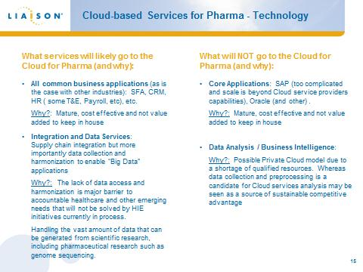
PISA Cloud Briefing in 2012…

Slide 5
Reality: More Cloud &Mobile
Allergan Case
34 Mobile
59 Cloud
2013
26 Mobile
39 Cloud
20 On-Premise
2012
Ratio of cloud to on-premise implementations is 1.95, further shifting portfolio toward cloud applications
Growth of mobile apps continues but has been slowed down by previous delivery of Skura, Agnitio and Bizsys (DSA) platforms

Slide 6
Risk and Challenges?
Integration
Migration
Privacy
Security
Liability
Transparency
Management
Cost
Availability
Notes:
How mature is Cloud? It has these issues that we see here today. And, these things will get worse before they get better.

Slide 7
Today’s Discussion….
How will Cloud adoption impact the organization risk profile?
Is Cloud adoption going to compromise my ability to meet regulatory mandates? How do I assure that all global regulations are met (e.g., privacy, SOX, GxP/CFR Part 11) and that effective management is in place?
How are security breaches handled and who is liable?
How do I know my company’s data is protected and how do I ensure data privacy is managed?
What information and security policies need to be updated to accommodate Cloud adoption?
Do I need new skills in the organization to be effective with security and compliance challenges?
Who has the primary relationship with cloud providers, I.T. or end-uses? Who pays for cloud services (e.g. AWS hosting of consumer facing websites, SFDC licenses)? How do we maintain flexibility/agility and positive customer experiences in the organization?
Challenges and risks for specific cloud services, e.g. SFDC

Slide 8
Attitudes Have Shifted

Slide 9
Multiple Options for Enterprises

Slide 11
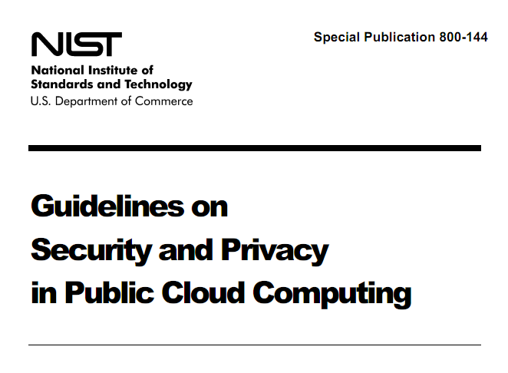
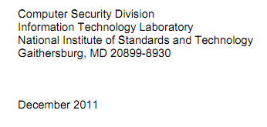
Trusted Advisors Recommend the Cloud
Potential benefits from transitioning to a public cloud computing environment:
  Staff Specialization
  Platform Strength
  Resource Availability
  Backup and Recovery
  Mobile Endpoints
  Data Concentration
Notes:
Granular, governable and auditable privilege assignment elevates security in the cloud above what’s achieved in legacy environments

Slide 12
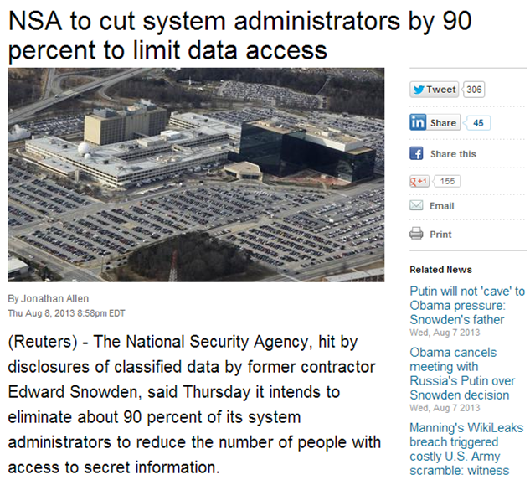
Trust: Without Which Nothing Else Matters
It’s essential to
  reduce complexity
  narrow the scope of privileges
rather than
  compounding complexity
  enlarging the attack surface

Slide 13
Is the “Cloud” Safe?
The “Cloud” is probably safer than your own datacenter
  Consider “comparative risk”
The cloud typically benefits from more robust security lifecycles and updates than standalone environments
  2012 PWC Survey: 50% reported improved security moving to cloud
Rare Technical Skills + Managed Complexity + Sustainable Economics = Security Win!

Slide 14
Data and Software in the Cloud
Need to have:
An understanding of your data protection needs
A strong data classification program
Data storage requirements
An understanding of data flows
Fully tested and documented controls maintained internally
Monitoring and governance
Need to receive:
Documentation and definition of data security controls and processes
Clear documentation on technical architecture and controls to be provided
Clarity on incident management and notification
Understanding of the audit and review process

Slide 15
Understand the vendor’s….
Infrastructure security
  Networking systems, storage
Application security
Data lifecycle including data destruction
Support model
  Who has access to what data?
  Incident response (prevention, detection, transparency)
Compliance
  PCI, SOX, other applicable audits
  Be prepared to build and maintain relationships with your cloud providers’ auditors
Not all vendors will meet your requirements
  Don’t be afraid to make security important to your business – it will provide an incentive for providers to improve

Slide 16
Build your solution
Data Flow
  How is data protected at all points in the flow?
  Document the demarcation where security accountability shifts from the customer to the provider
  Encryption used including algorithms and key management
    Understand the use and limits
Access model
  Authentication, authorization, access methods, accountability
  Does the model make sense for your business?
  Can you find and train the right individuals in your company to manage this?
Infrastructure
  Servers, database, physical security
Sustainability
  Can your vendor’s solution grow with your business?
  What kind of losses (data, financial, reputation, catastrophic) can your vendor withstand?
  How easy is it to exit the relationship and recover your data and operations?

Slide 17
Verify Before and After Signing
Who tests your provider?
  Rely on provider certifications and independent audit reports for the “routine stuff”
  Test everything else yourself or use a trusted third party
  Explore if the provider will allow penetration testing
  Use a trusted third party for testing and budget this cost as an annual operating expense
Assess-based on risk
  Invest more when it is high value data, regulated use, or core to your business
Don’t expect perfection
  Plan on test → vendor fix → retest cycle
  Judge the provider based on their responsiveness
Don’t forget to test the effectiveness of your own cloud security administration and governance!

Slide 18
Be Careful of Dependencies & Details
What points of integration are there?
  OAUTH inter-cloud relationships
  Credentials used for integration
  Administrator oversight
Who has admin access to your cloud?
Who is monitoring and how?
  What can you expect the provider to detect?
Is your provider aligned with your incident management team?

Slide 19
Key Questions
To ask your own org…
Have we fully evaluated the provider?
Do we have an end-to-end view of how data will flow and what this data is?
Do we have a well-documented demarcation in the security responsibilities of the provider and ours?
Have we aligned around compliance and policy requirements and have we engaged in a business risk discussion around gaps?
To ask your service provider…
Demonstrate to me that you are more than just “compliant” and “certified”
How transparent are you with regards to security?
  What can you not be transparent about? Why?
What is your security culture?
What things are you doing better than I can do?

Slide 20
Red Herrings
“Certification” and “Compliance” does not equal security
Encryption is not a magic silver security bullet
Almost all other aspects of security are more important and more complicated than “Datacenter Security”
Size, reputation, company history, etc. are not proxies for security
Multi-tenancy architectures vary – execution details matter, differences in architecture don’t

Slide 21
Thank you!

