Slide 2

2013
2014
2015
Every Business
is a Digital Business
From Digitally
Disrupted to
Digital Disrupter
Digital Business
Era: Stretch Your
Boundaries
2016
2017
People First:
Primacy of People
in the Digital Age
Technology for
People: The Era of the
Intelligent Enterprise

Slide 3
2017 VISION TRENDS
TECHNOLOGY BY PEOPLE
FOR PEOPLE
The Accenture Technology Vision 2017 identifies five technology trends that will empower people to achieve more in the era of the intelligent enterprise.

Slide 4



TREND 1
THE UNCHARTED
TREND 2
ECOSYSTEM POWER PLAYS
TREND 3
WORKFORCE MARKETPLACE
TREND 4
DESIGN FOR HUMANS
TREND 5
AI IS THE NEW UI

Slide 5



Slide 6
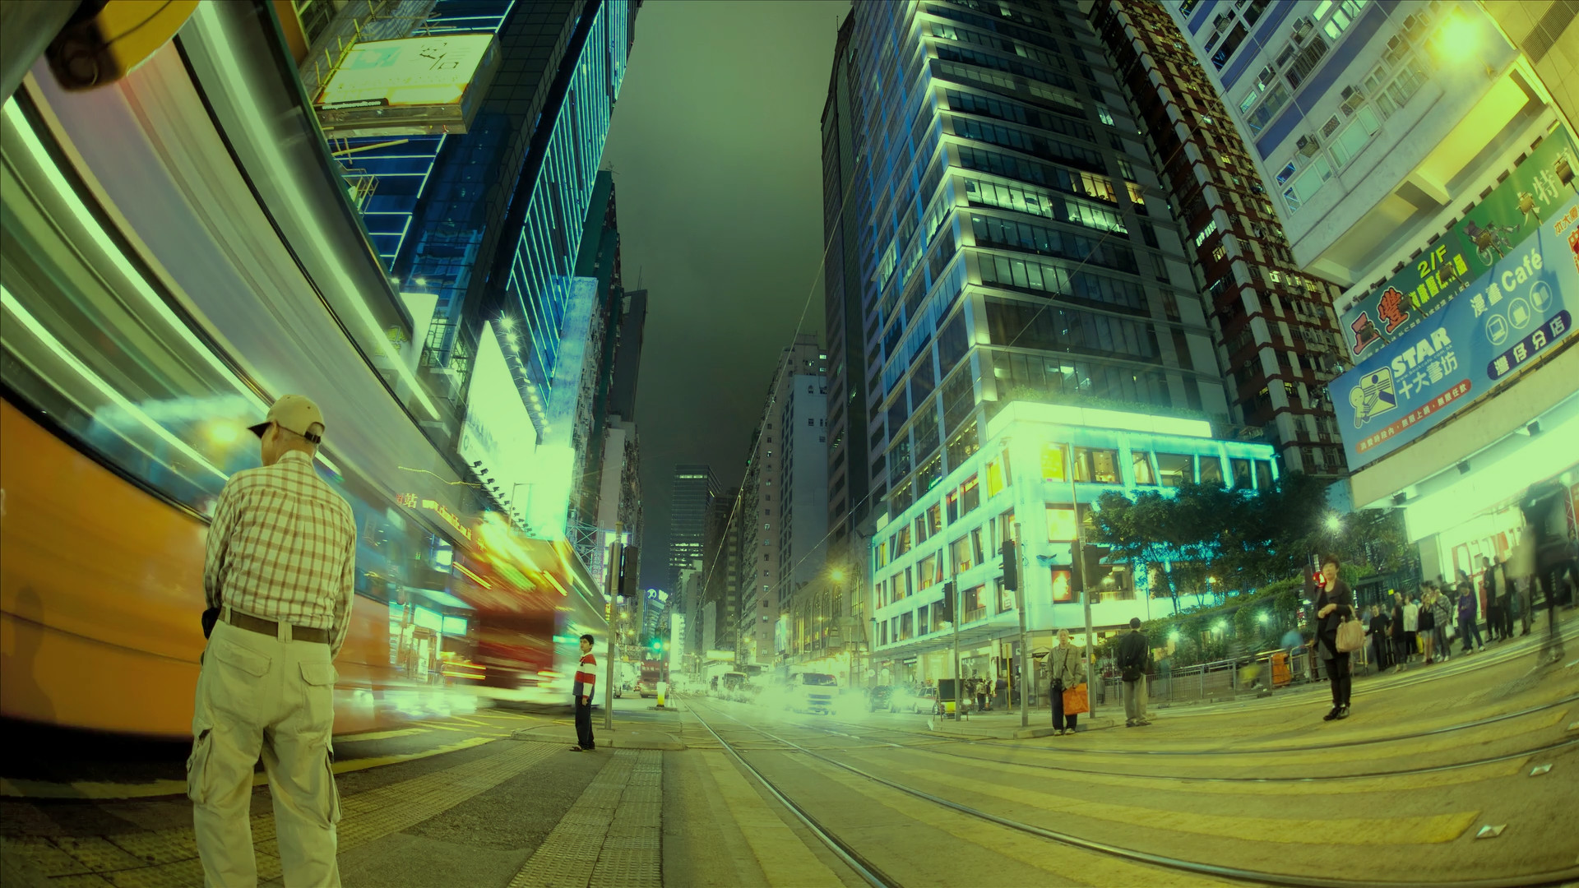
Invent New Industries
Set New Standards
To succeed in today’s ecosystem-driven
digital economy, businesses must seize
opportunities to establish rules and
standards for entirely new industries.

Slide 7


Slide 8
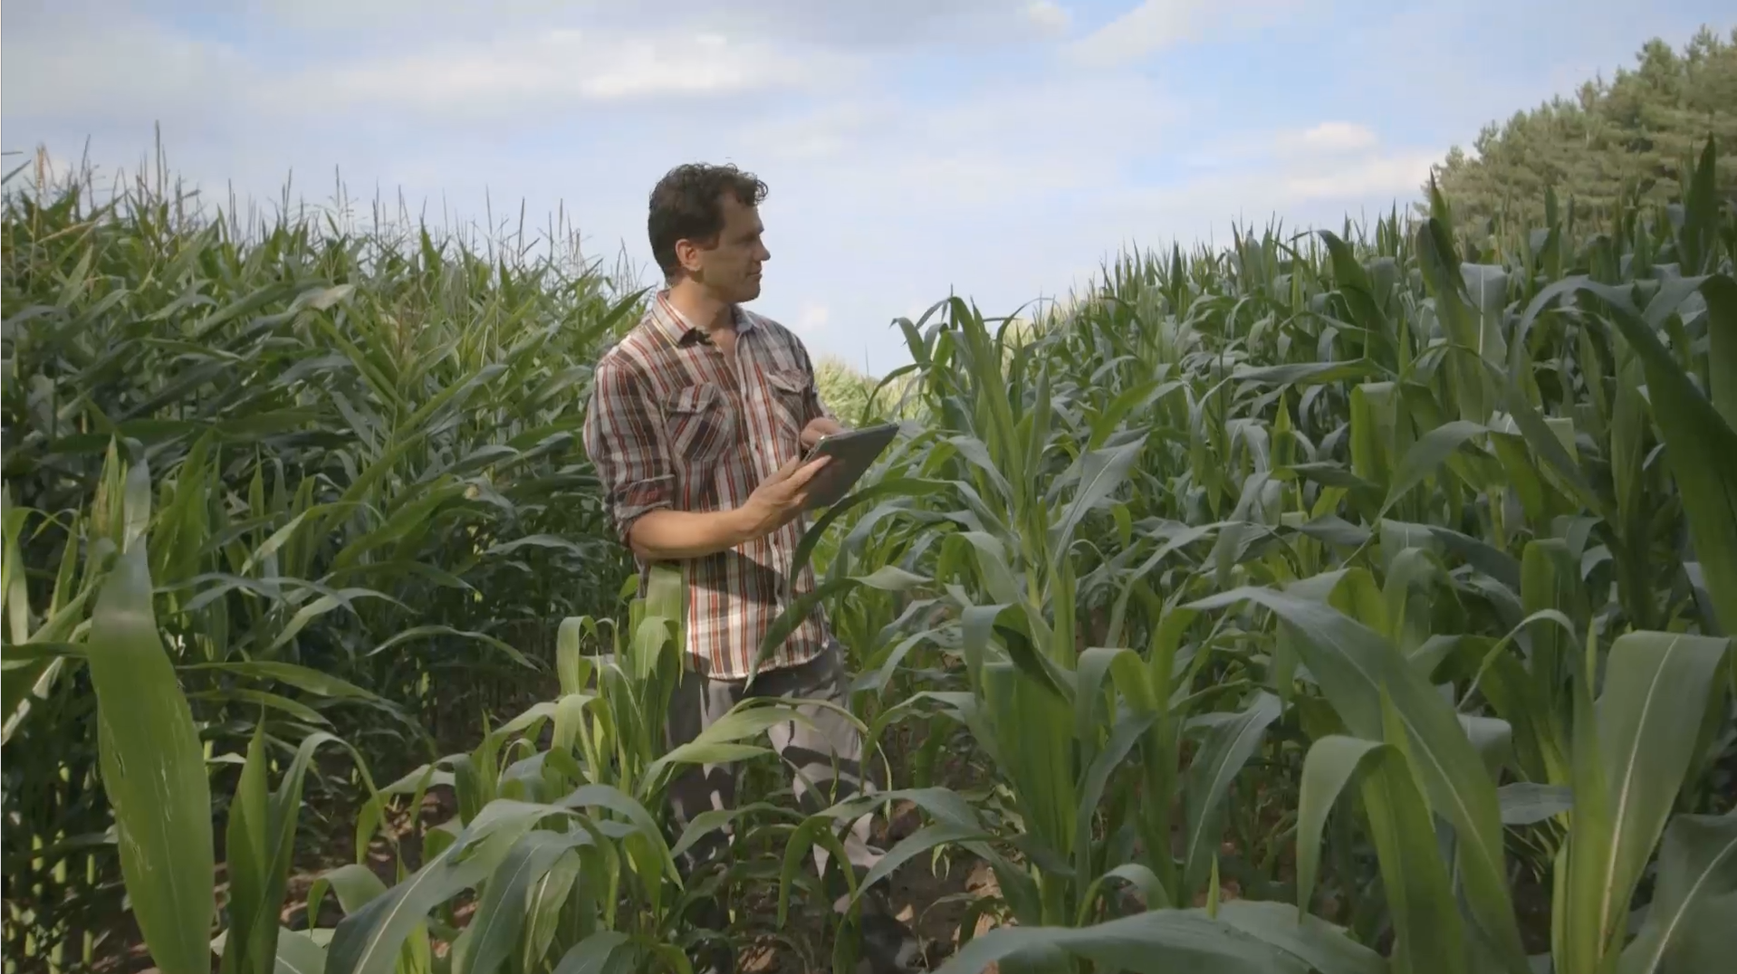
Beyond Platforms
Platform companies: completely
breaking the rules on to how operate
and compete… companies now need
more than just a platform strategy, they
need a robust ecosystem approach.

Slide 9


Slide 10
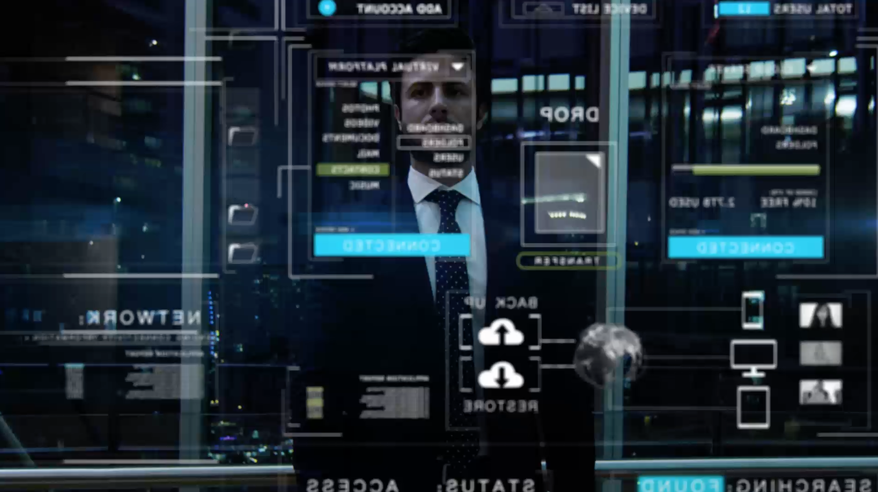
Invent your Future
On-demand labor platforms + surging
online management solutions =
talent marketplaces driving the most
profound economic transformation
since the Industrial Revolution.

Slide 11


Slide 12
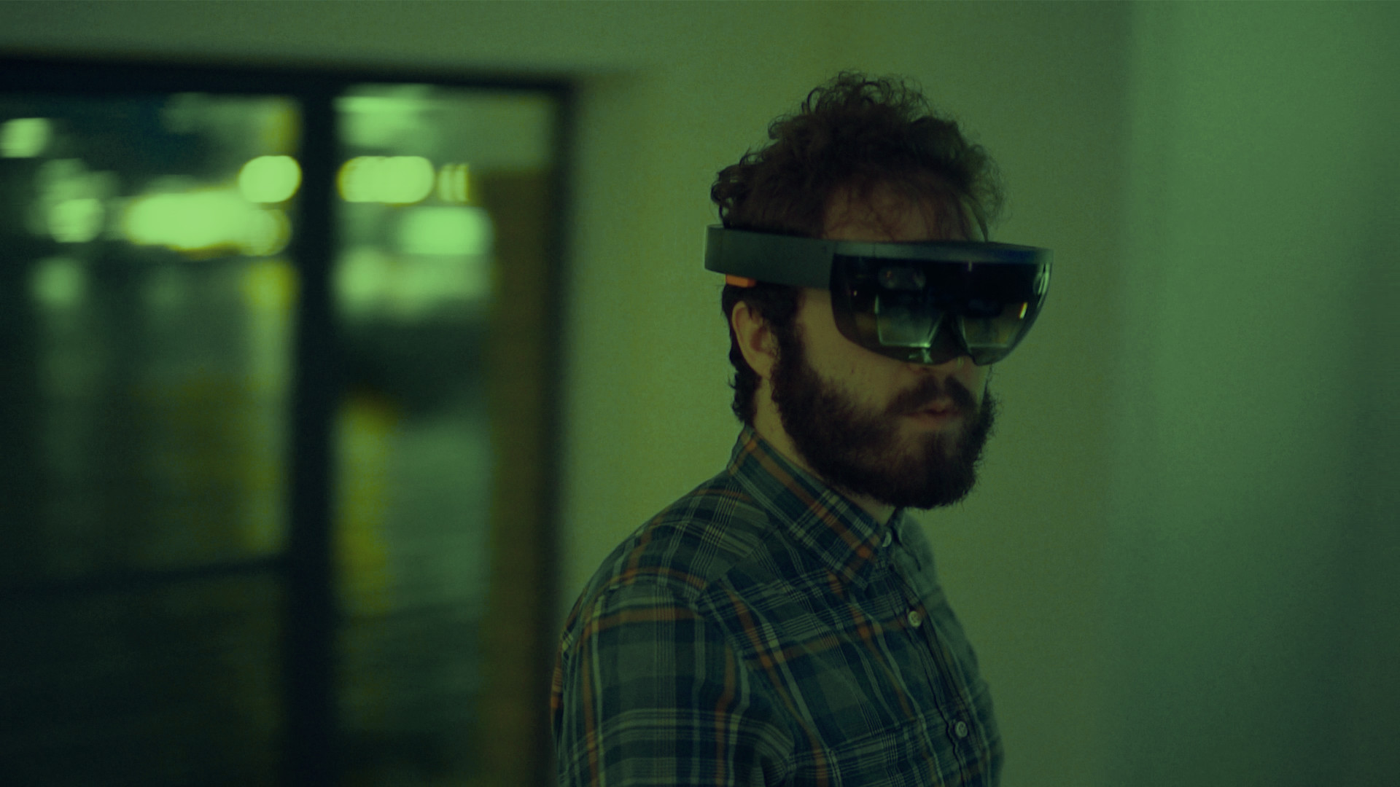
Inspire New Behaviors
Technology design decisions are
being made by humans, for humans…
technology is adapting to how we
behave to learn how to enhance
our lives.

Slide 13


Slide 14
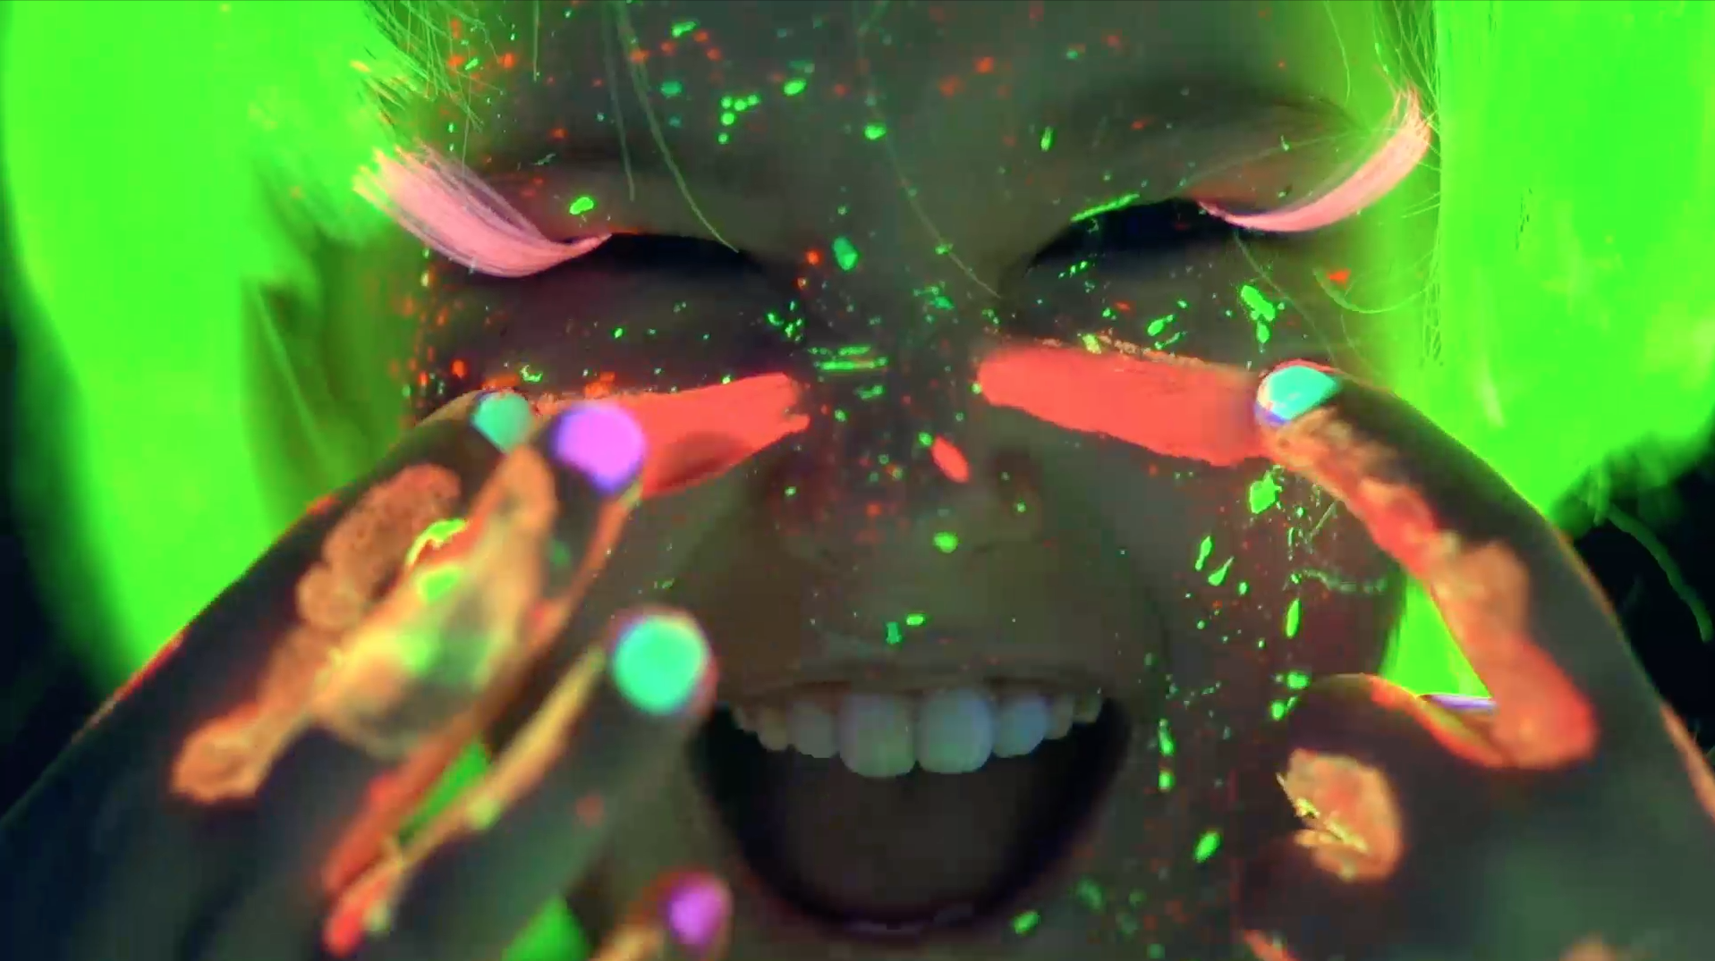
Experience Above All
Simple and smart interactions, value
at each connection made… resulting
in AI coming of age to become the
new user interface of every digital
business brand.

Slide 15
TECHNOLOGY
FOR PEOPLE
The Era of the Intelligent Enterprise
TREND 1
TREND 2
TREND 3
TREND 4
TREND 5
THE UN CHARTED
ECO
SYSTEM
POWER
PLAYS
WORK
FORCE MARKET PLACE
DESIGN
FOR
HUMANS
AI IS THE
NEW UI

